Slide 1
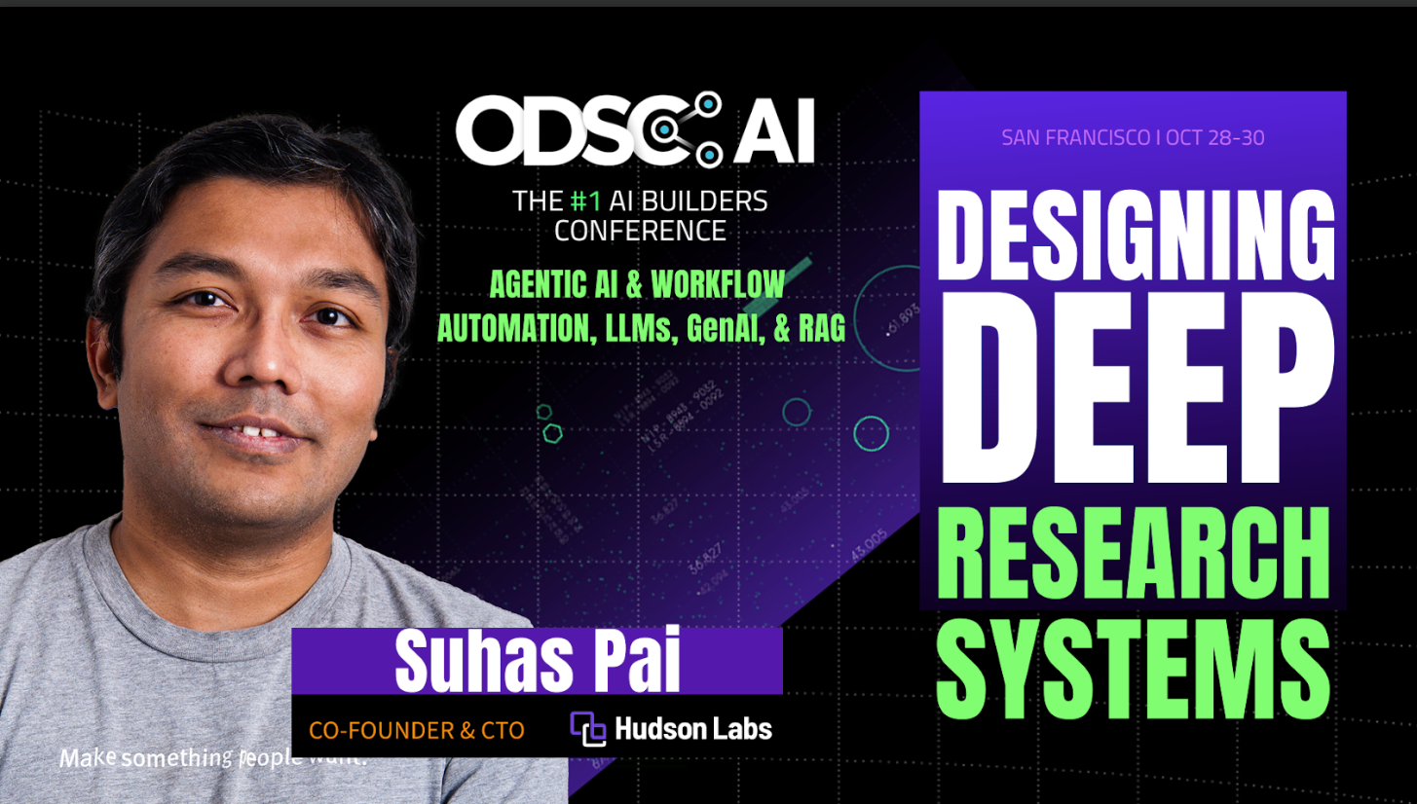
Anatomy of a Deep Research System
Suhas Pai, CTO, Hudson Labs

Slide 2

About Me
CTO & ML Research @ Hudson Labs (https://hudson-labs.com)
Book ‘Designing LLM Applications’ published by O’Reilly Media
Led/contributed to various open-source LLMs (BLOOM, Aurora-M etc.)
Chair, TMLS (Toronto Machine Learning Society) conference, 2021-present
Currently setting up an independent research group ‘llm-playbooks’

Slide 3
A system that takes an arbitrary number of retrieval and reasoning hops to resolve an information need in detail.

Slide 4
A religious experience
Company A lists Company B as a supplier in an obscure web page
An obscure local newspaper mentions a hurricane destroyed/disrupted all the manufacturing facilities in the same street that Company B is located in
Search alone is not sufficient for deep research

Slide 5
Components of a deep research system
Retrieval system
Reasoning system
Report Generation system
Context orchestrator
Depth and Breadth balancer

Slide 6
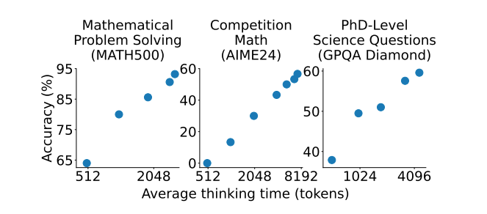
Scaling test-time compute works
Muennighoff et al: s1: Simple Test-time scaling

Slide 7
Parallel Scaling
Best-of-N
Self-consistency
Weighted self-consistency
Promising: Use smaller models for scaling

Slide 8
Best-of-N
Use a reward model for scoring
Use an LLM-as-a-judge for scoring
Use confidence measures for scoring
Solutions can be parallely or iteratively generated

Slide 9
Sequential Scaling
LLM-as-a-judge
External Verifiers (heuristics, reward models etc)
Needs large context windows*

Slide 10
Scaling Pitfalls
Overthinking
Underthinking
Hitting context length limitations
Difficulty in ascertaining confidence

Slide 11
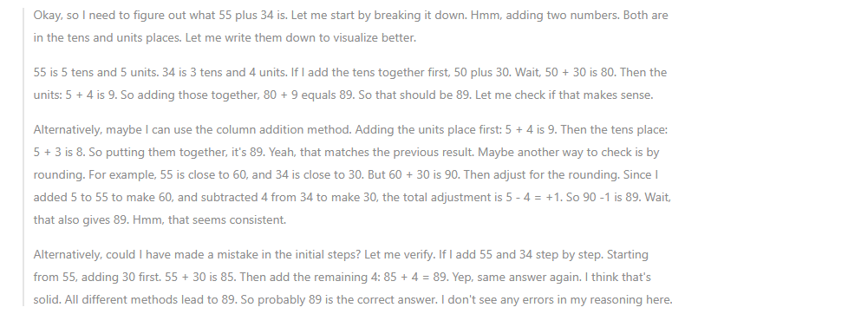
What is 55 + 34?

Slide 12
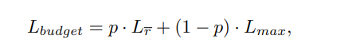
Fine-tuning for thought budgeting
Token Length Budgeting
p = proportion of samples with the correct answer
Lr = average thought length for correct answers
Lmax = maximum thought length
Shen at al. Difficulty-Adaptive Slow thinking for Large Reasoning Models

Slide 13
Reward function for thought budgeting
For correct answers:
If length crosses the budget, the reward will be decayed
If length is below the budget, reward will be enhanced
For incorrect answers:
If the length is below the budget, reward will be decayed.
If the length hits the budget, the reward is saturated.

Slide 14
Retrieval System
WHAT to search
WHEN to search
HOW to search

Slide 15
WHAT to search - Query generation module
Bottom Up vs Top Down queries
Level of Detail as a hyperparameter
Tightly coupled search system

Slide 16
Retrieval Pipeline
Retrieve
Rerank
Refine (needs reasoning)

Slide 17
Orchestrator
Interleaving retrieval, reasoning, and generation
Knowing when to stop
Internal vs External decisions

Slide 18
Context Engineering
Knowing what the task is
Knowing what content has been searched through so far
Knowing how the content searched through relates to the task
Knowing current state of answer generation

Slide 19
Depth and Breadth Balancer
Depth - going through rabbit holes
Breadth - search through multiple pieces of content parallely
Keep depth and breadth threshold and ceiling - static or dynamic

Slide 20
Deep Research Evaluation Strategies

Slide 21
Strategy 1: Invent scenarios
Construct documents whose combination leads to ‘emergent knowledge’
The ‘emergent knowledge’ is not explicitly stated in any single document but synthesized from several documents.
Bury these documents among a large related document collection
Optional: The related document collection is also collected synthetically.

Slide 22
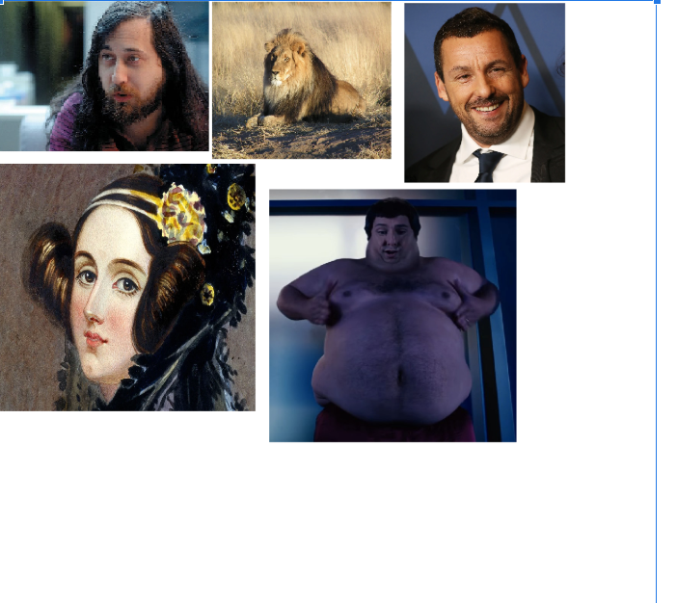
Example - Lateral thinking

Slide 23
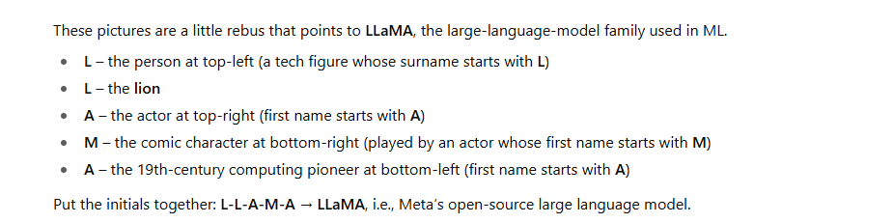
Example - Lateral thinking

Slide 24
Strategy 2: Wikipedia as the sole collection
Example: Gandhi and the Eiffel Tower
Was Mahatma Gandhi in Paris during the inauguration of the Eiffel Tower?
Evidence: Wikipedia pages of Eiffel Tower and Mahatma Gandhi, quotes by Gandhi about the Eiffel Tower

Slide 25
Strategy 3: Wikipedia edits
Edit Wikipedia docs (locally) to remove obvious clues
Question: Did Djibril Cisse ever play against Papiss Cisse?

Slide 26
Evaluation at the component level
Retrieval -> Did it retrieve all pertinent information?
Retrieval -> Did it retrieve more documents than it should have?
Report Generation system -> Did the final report contain the information we need?
Reasoning system -> Was the system able to draw connections between different documents?

Slide 27
Metrics
Factuality
Citability
Non-repetitiveness
Specificity
Coherence
Novelty
Usefulness
Structure
Formatting
Completeness
Precision

Slide 28
Contact
piesauce.substack.com
https://x.com/piesauce
https://www.linkedin.com/in/piesauce/

